Slide 1
BUBBLE SORT
Submitted by Jamil Rayhan
ID: 18CSE061

Slide 2
What is sort?
Sorting is the process of arranging data into meaningful order
So that we can analyze it more effectively

Slide 3
Bubble Sort Definition
Bubble sort is the easiest sorting algorithm to implement.
It is inspired by observing the behavior of air bubbles over foam.
It is an in-place sorting algorithm.
It uses no auxiliary data structures (extra space) while sorting.

Slide 4
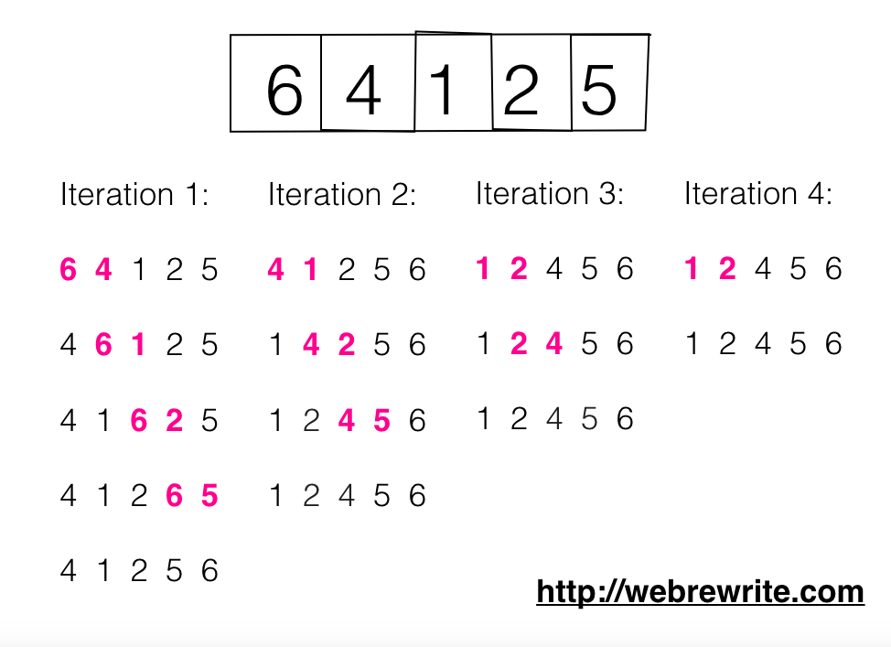
Pictorial Representation

Slide 5
How Bubble Sort Works?
Bubble sort uses multiple passes (scans) through an array.
In each pass, bubble sort compares the adjacent elements of the array.
It then swaps the two elements if they are in the wrong order.
In each pass, bubble sort places the next largest element to its proper position.
In short, it bubbles down the largest element to its correct position.

Slide 6
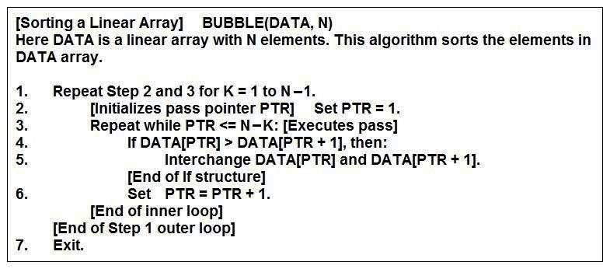
Bubble Sort Algorithm

Slide 7
Pseudocode
We are given with an input array which is supposed to be sorted in ascending order
We start with the first element and i=0 index and check if the element present at i+1 is greater then we swap the elements at index i and i+1.
If above is not the case, then no swapping will take place.

Slide 8
Pseudocode(Cont.)
Now “ i ” gets incremented and the above 2 steps happen again until the array is exhausted.
We will ignore the last index as it is already sorted.
Now the largest element will be at the last index of the array.

Slide 9
Pseudocode(cont.)
Now we will again set i=0 and continue with the same steps that will eventually place second largest at second last place in the array. Now the last 2 indexes of the array are sorted.

Slide 10
Time Complexity
Each and every element is compared with the other elements for array which takes n time
Best Case Time Complexity: O(n)
Average Case Time Complexity: O(n^2)
Worst Case Time Complexity: O(n^2)

Slide 11
Space Complexity
Bubble sort uses only a constant amount of extra space for variables like flag, i, n.
Hence, the space complexity of bubble sort is O(1).
It is an in-place sorting algorithm .It modifies elements of the original array to sort the given array.

Slide 12
Properties
Bubble sort is a stable sorting algorithm.
Bubble sort is an in-place sorting algorithm.
Number of swaps in bubble sort = Number of inversion pairs present in the given array.
Bubble sort is beneficial when array elements are less and the array is nearly sorted.

Slide 13
Thank You

